Slide 1
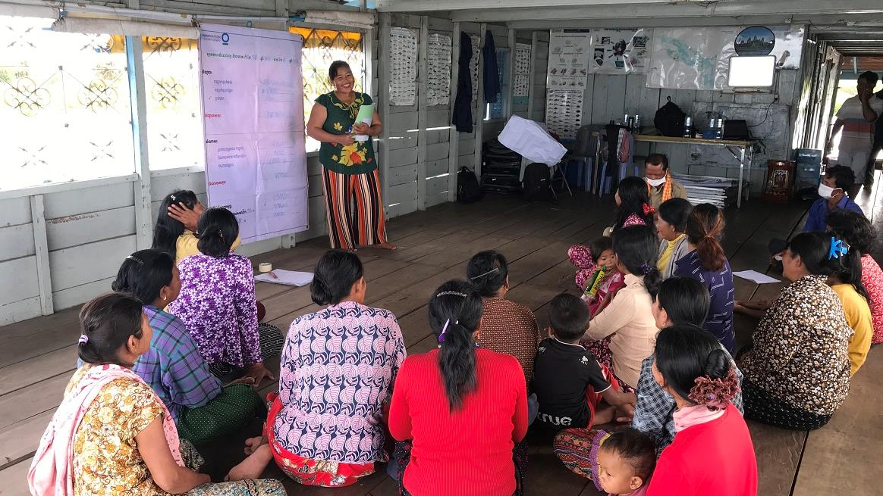
Women’s savings group meeting in Ou Akol, Cambodia. © Sokrith Heng, Conservation International
Empowering women in conservation
KNOWLEDGE PRODUCT
Keiruna
inc
TRAINING MODULES

Slide 2
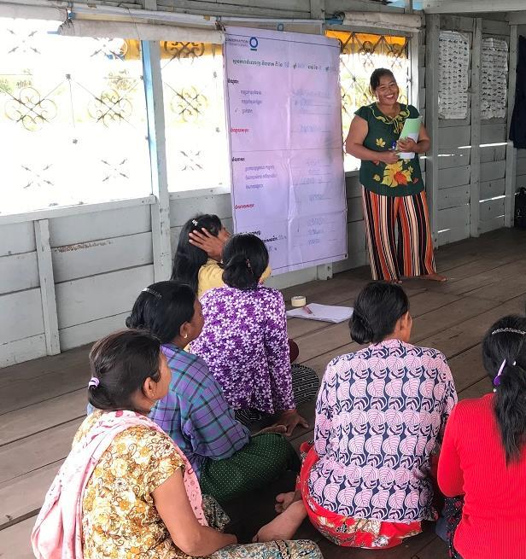
About
This knowledge product is based on experiences of CEPF Grantees in the Indo-Burma Hotspot, and is meant to provide useful information and guidelines for supporting women in conservation. Licensed under CC BY-NC 4.0.
Funded as a part of the CEPF "Building on Success" learning resource series, which aims to promote effective conservation practices across the planet.
Empowering women in conservation
How to use this knowledge product
This is a training with 3 modules that can be self-guided or delivered by a trainer to a group, with extra explanations in the optional Training Script document.
For more in-depth information on any of the topics covered, there are many useful references available, including those in the Annex (Further Learning).
CEPF is a joint initiative of l’Agence Française de Développement, Conservation International, the European Union, the Global Environment Facility, the Government of Japan and the World Bank.
Published 2021 | Author: Tara Sayuri Whitty, PhD. @ Keiruna Inc

Slide 3
EMPOWERING WOMEN IN CONSERVATION
Modules
Module 1
Module 2
Module 3
Annex
Why gender is important in conservation
Context, Rationale, and Key Considerations
Framework:
Working to empower women in conservation
Ways of thinking & Working in projects
Further learning:
Useful resources

Slide 4
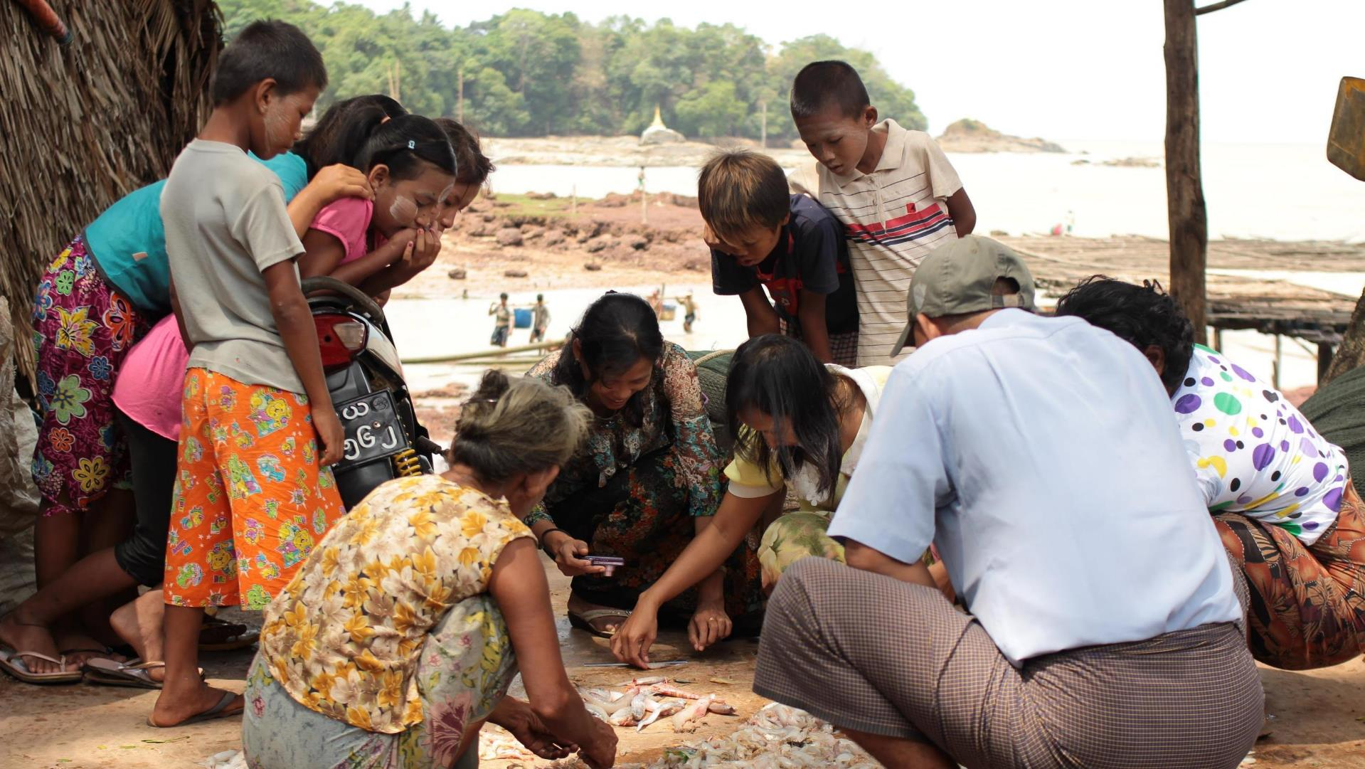
EMPOWERING WOMEN IN CONSERVATION
Module 1
Why gender is important in conservation
Village women showing a female research team how they sort the fish catch in Mon State, Myanmar. © TSWhitty

Slide 5
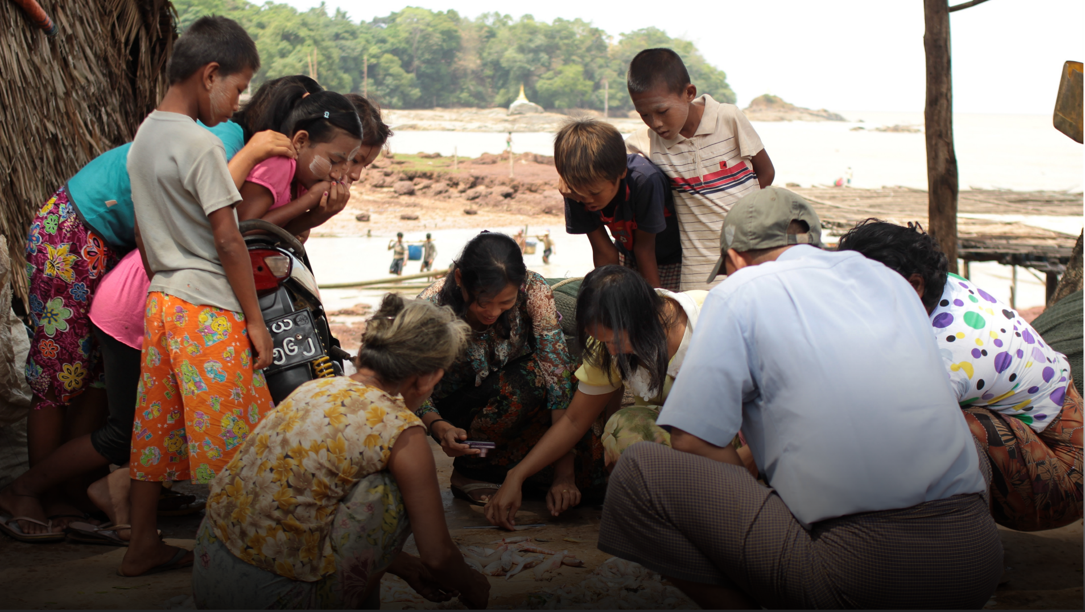
MODULE 1 | WHY GENDER IS IMPORTANT IN CONSERVATION
Because conservation is important for the well-being of women and their families, women:
can be powerful and motivated advocates for conservation
can inform conservation efforts about how their communities depend on natural resources
should have the right to be involved in decisions that affect the resources they depend on.

Slide 6
MODULE 1 | WHY GENDER IS IMPORTANT IN CONSERVATION
Women's reliance on natural resources
Women's experience & knowledge
Women's rights are human rights
3 REASONS WHY WOMEN SHOULD BE INVOLVED IN CONSERVATION

Slide 7
MODULE 1 | WHY GENDER IS IMPORTANT IN CONSERVATION
Women's reliance on natural resources
Women's experience & knowledge
Women's rights are human rights
Threats to natural resources can negatively impact communities who depend on them.
This includes women and the households that they often manage.
These impacts can be different between men and women depending on gender roles, so it is important to understand how women – and their families - use and rely on resources.

Slide 8
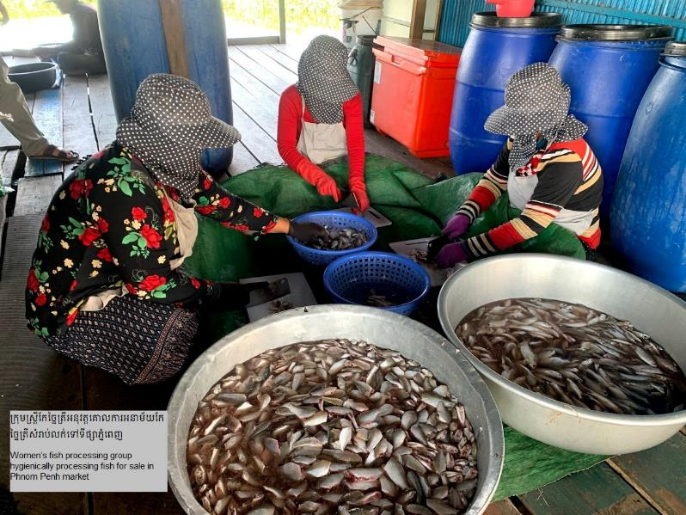
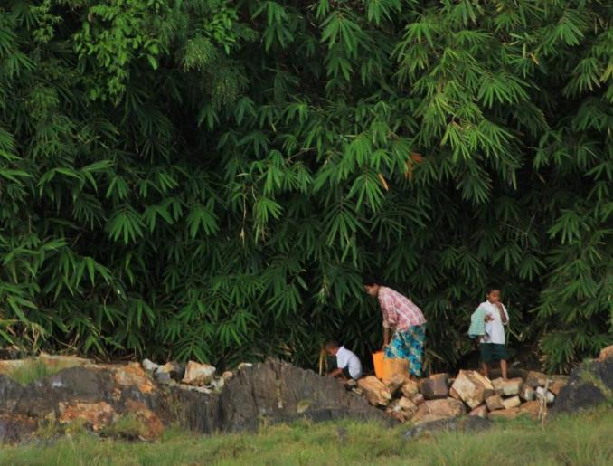
MODULE 1 | WHY GENDER IS IMPORTANT IN CONSERVATION
Women's reliance on natural resources
Cambodia
“In our project area, most non-timber forest product (NTFP) use is by women. They are the main ones responsible for collecting water, vegetables, and firewood from the forest. So they are particularly vulnerable to land loss.”
Highlanders Association
Cambodia
“Because many of them work in fish processing, women benefit from strong community fisheries management. If the Community Fisheries Committee is not managing fisheries effectively, it will impact women’s livelihoods.”
Conservation International (CI)
Women’s fish processing group in Ou Akol, Cambodia
© Kriya Sith, CI
Woman going to fetch water in Mon State, Myanmar. © TSWhitty

Slide 9
MODULE 1 | WHY GENDER IS IMPORTANT IN CONSERVATION
Women's reliance on natural resources
Women's experience & knowledge
Women's rights are human rights
Women can contribute to conservation with their knowledge, experience, and skills related to how they use resources, manage their livelihoods and households, and participate in their communities.
These can includes knowledge and skills that they already have, as well as knowledge and skills that they can learn and use in the future.

Slide 10
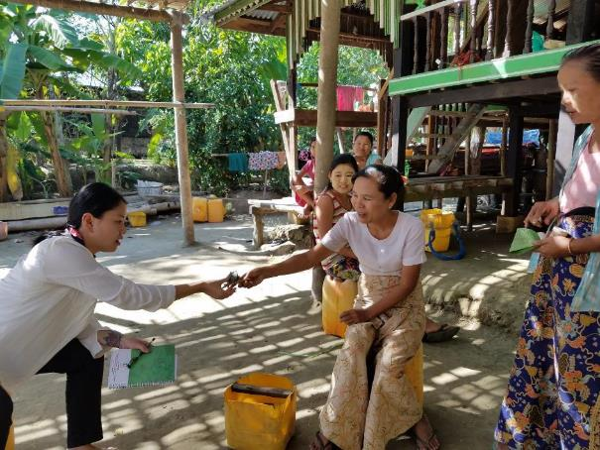
MODULE 1 | WHY GENDER IS IMPORTANT IN CONSERVATION
Women's experience & knowledge
northern Vietnam
Women have an important role in processing aquaculture products.
So they have the skills to contribute to projects on making those products more valuable.
This includes a “queen of the kitchen” competition to promote product innovations.
Center for Water Resources Conservation and Development (WARECOD)
Cambodia
With their experience in managing household finances, women are seen as strong with financial management.
Fisheries Action Coalition Team (FACT)
Thailand
Women have particular knowledge about food from local edible plants, so they lead Local Ecological Knowledge research efforts on these resources
Mekong Community Institute Assoc. (MCI)
Women teaching visiting researchers about the mud crab market chain. Gulf of Mottama, Myanmar. © TSWhitty

Slide 11
MODULE 1 | WHY GENDER IS IMPORTANT IN CONSERVATION
Women's reliance on natural resources
Women's experience & knowledge
Women's rights are human rights
Ethically, it is important that women have the right to be involved in decisions that affect their well-being.
Internationally, women’s rights are recognized under the Convention on the Elimination of All Forms of Discrimination against Women (CEDAW 1979). Many countries also have policies protecting women’s rights. Many donors and funding sources have gender mainstreaming policies and requirements.

Slide 12
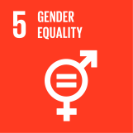
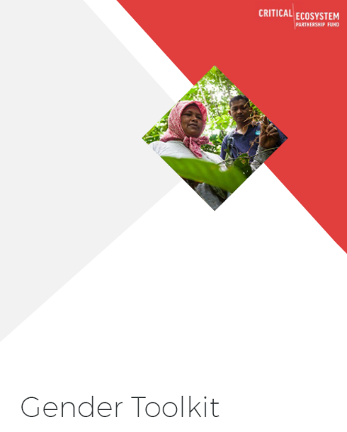
MODULE 1 | WHY GENDER IS IMPORTANT IN CONSERVATION
Sustainable Development Goals
SDG 5: Achieve gender equality and empower all women and girls
Including Target 5.5: Ensure women’s full and effective participation and equal opportunities for leadership at all levels of decision-making in political, economic, and public life.
Women's rights are human rights
CEPF Gender Policy
“...Gender issues and considerations will be actively incorporated throughout the grant-making process and progress on gender-related outcomes will be monitored.”

Slide 13
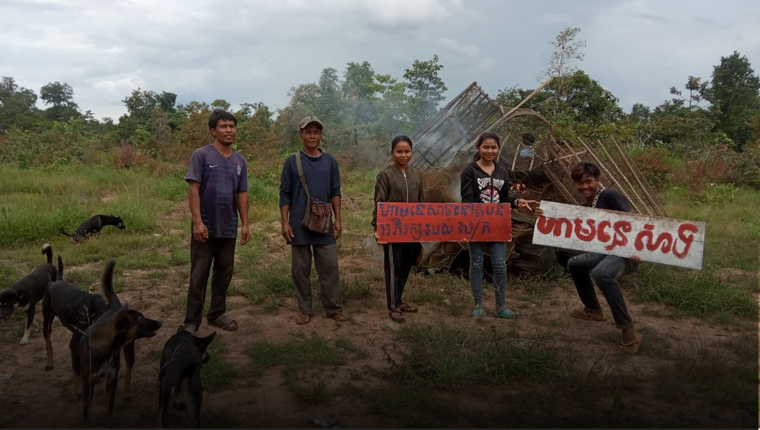
MODULE 1 | WHY GENDER IS IMPORTANT IN CONSERVATION
This is not just a "women's issue"
Gender focal persons
© Kbal Romeas village,
My Village
Their communities (the “bird”) will fly farther if both wings work together
Men & women are "2 wings of the same bird"
If women do not have a voice, society loses opportunities to benefit from their ideas, solutions, contributions to communities & conservation

Slide 14
MODULE 1 | WHY GENDER IS IMPORTANT IN CONSERVATION
This is not just a "women's issue"
Men can also be harmed by gender biases & stereotypes about men & masculinity
Men can be "gender champions" that support women & help build their capacity to work in conservation

Slide 15
MODULE 1 | WHY GENDER IS IMPORTANT IN CONSERVATION
This is not just a "women's issue"
Men, women, & children can benefit
from gender mainstreaming in conservation!
Men & women can work together as partners to inform, develop, and implement solutions that are important for their communities.

Slide 16
MODULE 1 | WHY GENDER IS IMPORTANT IN CONSERVATION
Women can be effective agents of change
ENHANCED ECONOMIC DEVELOPMENT
Development and humanitarian projects have found that where women are meaningfully included in community activities and decisions, the whole community benefits from:
IMPROVED PROSPECTS FOR FUTURE GENERATIONS
STRENGTHENED POLITICAL & SOCIAL SYSTEMS

Slide 17
MODULE 1 | WHY GENDER IS IMPORTANT IN CONSERVATION
Women can be effective agents of change
ENHANCED ECONOMIC DEVELOPMENT
When women are more educated and empowered, economies & community well-being grow:
IMPROVED PROSPECTS FOR FUTURE GENERATIONS
→ Greater sharing in problem solving
→ More opportunities for all
→ Benefits for children include:
Reduced child mortality
Improved health & opportunities mean better quality of life for future generations
STRENGTHENED POLITICAL & SOCIAL SYSTEMS

Slide 18
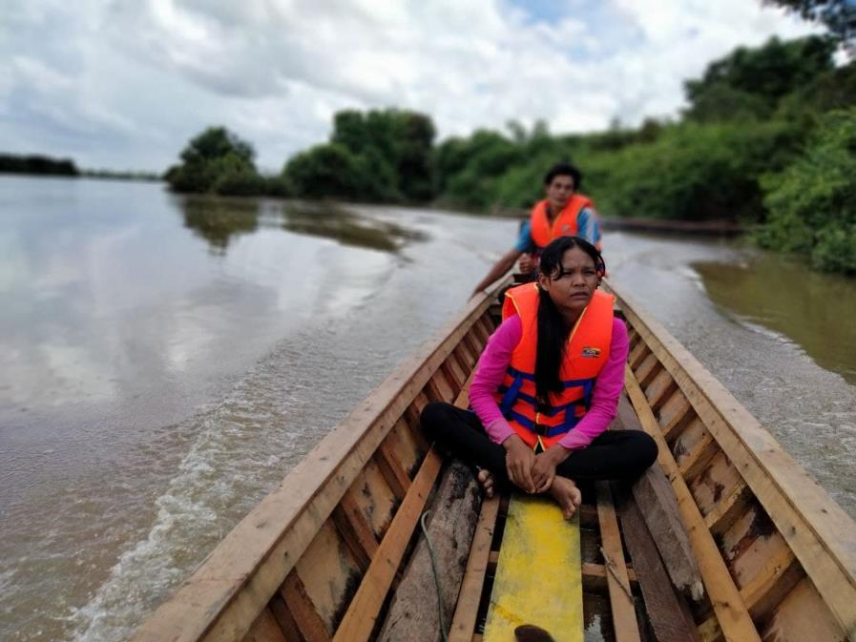
MODULE 1 | WHY GENDER IS IMPORTANT IN CONSERVATION
Women can be effective agents of change
Research + Monitoring
Women lead Local Ecological Knowledge research on local edible plants and present their findings to communities, authorities, and other organizations with our support
Thailand | MCI
Women who gained knowledge and skills with our project became more motivated to take care of community issues and are capable of mobilizing communities against threats like land encroachment and illegal fishing
Cambodia | FACT
Monitoring local lakes in Cambodia © 3S Rivers Protection Network (3SPN)

Slide 19
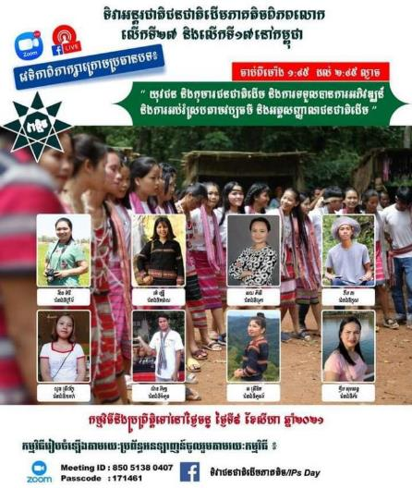
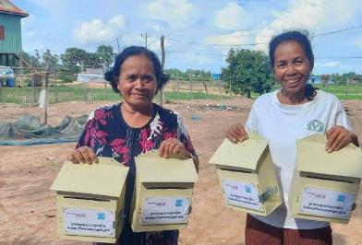
MODULE 1 | WHY GENDER IS IMPORTANT IN CONSERVATION
Women can be effective agents of change
Advocacy
After building their skills and experience with the project, women are confident in approaching local authorities and other stakeholders to advocate for their communities.
Cambodia | My Village
Raising awareness
Women are now active in sharing information on indigenous communities’ issues (including women’s issues) to national and international platforms, such as National Indigenous People’s Day and Facebook Live talkshows
Cambodian Indigenous Youth Association (CIYA)
Women are able to facilitate meetings, produce and submit reports to Commune Councils and local Fisheries Administration officials, and advocate to the public, media, and national government.
They are also strong advocates at international and regional events, such as the Save the Mekong Coalition.
Cambodia | FACT
Announcement for Facebook Live event featuring women’s voices © CIYA
Community Fishery committee members spreading information on recourse mechanisms © FACT

Slide 20
Gender Norms
MODULE 1 | WHY GENDER IS IMPORTANT IN CONSERVATION
Behaviors or attributes that society assigns to a particular sex.
Gender Perspective
Taking into account gender-based differences when looking at any social phenomenon, policy, or process
Gender Balance
Some important terms
Commonly used in reference to equal participation of women and men in all areas of work, projects or programs
Gender Integration
Strategies applied in program assessment, design, implementation, & evaluation to take gender norms into account and to compensate for gender-based inequalities
Gender Equality
State or condition that affords women & men equal enjoyment of human rights, socially valued goods, opportunities, and resources
From the CEPF Gender Policy + Gender Toolkit
Gender Mainstreaming
Gender Equity
Incorporating a gender perspective into policies, strategies, programs, project activities, and administrative functions, as well as into the institutional culture of an organization
The process of being fair to women and men. Measure must be taken to compensate for historical & social disadvantages that prevent women & men from operating on a level playing field.

Slide 21
Gender Norms
MODULE 1 | WHY GENDER IS IMPORTANT IN CONSERVATION
What activities & behaviors are expected of women & men based on their gender
Gender Perspective
Considering gender issues (norms, roles, experiences of men & women) in your work
Gender Balance
Some important terms
Having equal participation of women & men (50:50) in an activity, project, organization
Gender Integration
Implementing a gender perspective in
your work; incorporating an understanding of gender norms, existing inequalities between men & women, and ways of working for greater equality and equity
Gender Equality
Where women & men can equally access and benefit from opportunities, resources, and rights
From the CEPF Gender Policy + Gender Toolkit
Gender Equity
Gender Mainstreaming
SIMPLIFIED
A context that is fair to women and men, which includes compensating for historical and ongoing imbalances (or unfair conditions); e.g., supporting women to overcome disadvantages due to unequal access to education
Applying gender integration throughout your activities, project, and organization

Slide 22
Underlying Context
MODULE 1 | WHY GENDER IS IMPORTANT IN CONSERVATION
Gender norms:
Social expectations about what the different genders can & should do
Gender roles in the household & community
Unequal access to education
In many cultures, gender norms include expectations that:
Women care for the children
Women are responsible for managing household duties, including cooking and cleaning
It is not appropriate/safe for women to act or travel independently
Men are the leaders in the communities and in the household
This shapes the roles that women take in the community and in households.
It also means that girls & women are often not provided equal access to education as boys & men, since it is expected they will not work outside of the house

Slide 23
Underlying Context
MODULE 1 | WHY GENDER IS IMPORTANT IN CONSERVATION
Gender norms:
Social expectations about what the different genders can & should do
Gender roles in the household & community
Unequal access to education
Perceptions & Biases
Perception that women don’t have the right or place to be involved
Bias against women’s knowledge and perspectives
Perception that women don’t have the capacity to be involved

Slide 24
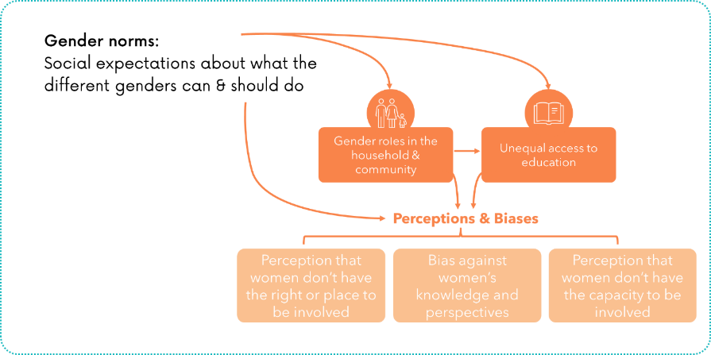
Underlying Context
MODULE 1 | WHY GENDER IS IMPORTANT IN CONSERVATION
So, gender issues are rooted in deeply-held beliefs, tradition, and practices – and so can be difficult and complicated to change.
It is important to consider this context when designing & implementing activities involving women or related to gender issues!

Slide 25
MODULE 1 | WHY GENDER IS IMPORTANT IN CONSERVATION
Gender mainstreaming across institutions
(More in MODULE 2)
CONSERVATION ORGANIZATIONS
(NGOs, CSOs)
COMMUNITIES
AUTHORITIES, DECISION-MAKERS above village level

Slide 26
MODULE 1 | WHY GENDER IS IMPORTANT IN CONSERVATION
Gender mainstreaming across institutions
Conservation Organizations can incorporate gender considerations within their own organization through:
Developing a gender policy for the organization & its activities
Committing to equity in hiring women & men
Ensuring that women have access to higher positions & decision-making
Policies, practices to support female staff
Enabling environment for women: organization’s culture, norms (women feel respected, safe, supported)
Organizational capacity for gender equity: Building staff awareness, obtaining resources to support gender equity
CONSERVATION ORGANIZATIONS
(NGOs, CSOs)
COMMUNITIES
AUTHORITIES, DECISION-MAKERS above village level

Slide 27
MODULE 1 | WHY GENDER IS IMPORTANT IN CONSERVATION
Gender mainstreaming across institutions
Within communities, supporting greater gender equity includes:
CONSERVATION ORGANIZATIONS
(NGOs, CSOs)
Understanding gender roles and norms in households, communities, and natural resource use & management
Working with women & men to raise awareness of the importance of women’s involvement
Supporting representation of women in activities, leadership, and decision-making
COMMUNITIES
AUTHORITIES, DECISION-MAKERS above village level

Slide 28
MODULE 1 | WHY GENDER IS IMPORTANT IN CONSERVATION
Gender mainstreaming across institutions
Supports for gender equity among authorities and decision-makers above the village level can include:
CONSERVATION ORGANIZATIONS
(NGOs, CSOs)
Improved gender representation in positions of influence (decision-makers, authorities, lawyers, government officials, national media)
Platforms for sharing women’s voices to audiences beyond their communities
Incorporation of women’s voices & ideas in state, national, and international decisions and policies
COMMUNITIES
AUTHORITIES, DECISION-MAKERS above village level

Slide 29
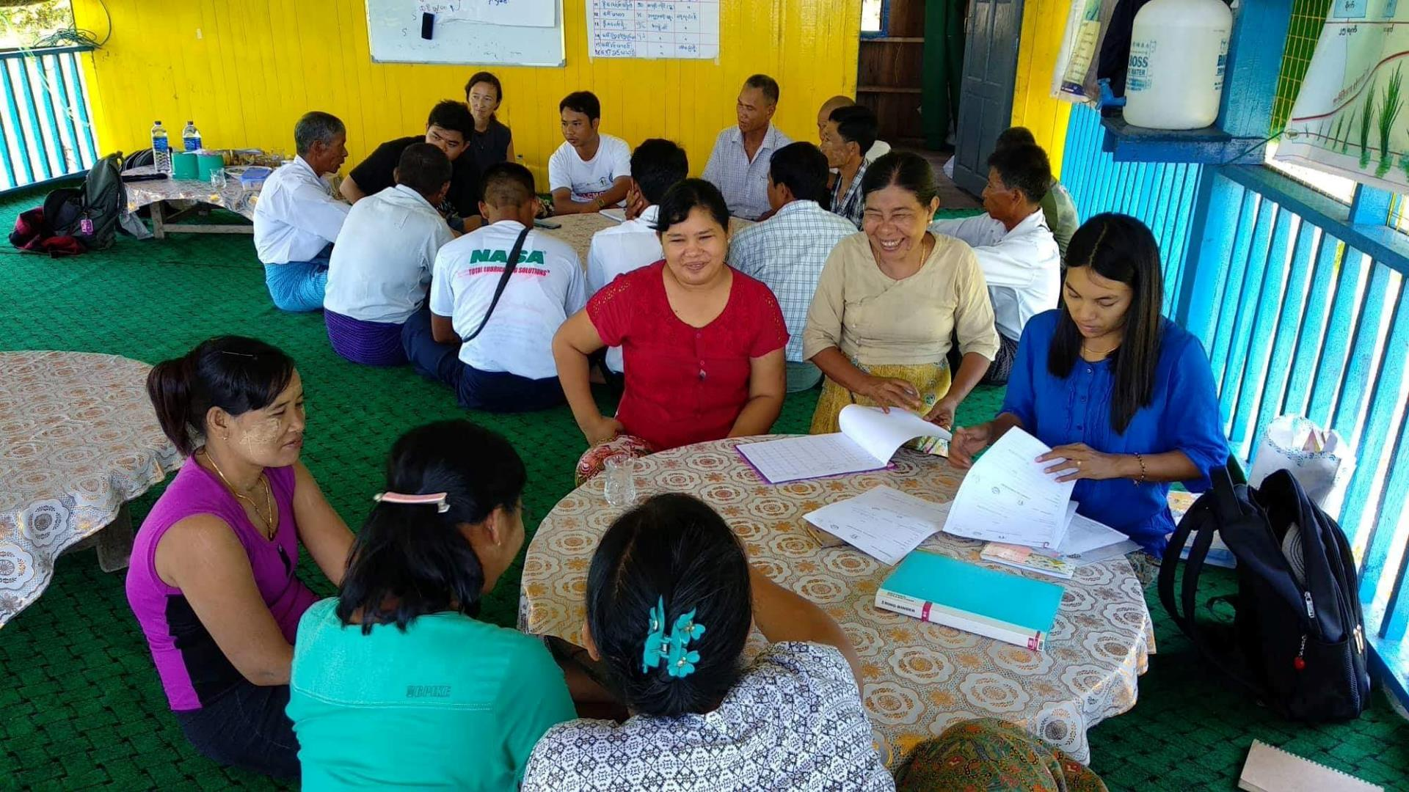
Key principles & Considerations
MODULE 1 | WHY GENDER IS IMPORTANT IN CONSERVATION
Focus Group Discussions on project impacts to women and men in the Gulf of Mottama Project. © TSWhitty

Slide 30
Key principles & Considerations
MODULE 1 | WHY GENDER IS IMPORTANT IN CONSERVATION
Context sensitivity
“Do No Harm”
Meaningful
participation
Intersectionality

Slide 31
Key principles & Considerations
MODULE 1 | WHY GENDER IS IMPORTANT IN CONSERVATION
Understand & be sensitive to the local context of gender roles and related dynamics. Make sure that your plan and activities are appropriate to the local context.
Context sensitivity

Slide 32
Key principles & Considerations
MODULE 1 | WHY GENDER IS IMPORTANT IN CONSERVATION
A common principle for humanitarian aid and medical professionals: The well-being of the people we are trying to help must be the focus of our efforts to help them.
→ Project interventions must not cause harm to the target communities.
“Do No Harm”

Slide 33
Key principles & Considerations
MODULE 1 | WHY GENDER IS IMPORTANT IN CONSERVATION
Many projects might aim for 50% (or similar) of their activity participants to be women, but this does not tell us much about how these women are participating.
It is important to support women to actively participate (and lead), not just to attend meetings without acting
Meaningful
participation

Slide 34
Key principles & Considerations
MODULE 1 | WHY GENDER IS IMPORTANT IN CONSERVATION
Gender is important, but there are many other factors that also influence how a person is treated.
These include: ethnicity; religion; socioeconomic status; disability; age. These can also interact to have a combined effect (e.g., experiences of indigenous women, indigenous men, non-indigenous women, and non-indigenous men are all different)
Intersectionality

Slide 35
CAUTION
MODULE 1 | WHY GENDER IS IMPORTANT IN CONSERVATION
Husbands/other family members not approving of their wives being active in the community
Wives not having enough time to participate in activities and tend to their household/childcare duties → husbands/other family members get upset
Disapproval/gossip from community members about women who become active outside of their households
A common issue that comes up when projects work to engage women is an increase in conflict in households.
This can be a result of:
CRITICALLY IMPORTANT
ensure that your activities avoid this as much as possible –
through engaging husbands, families, and communities to help them understand and support women’s involvement, as well as making it easier for women to participate while maintaining their household activities

Slide 36
CAUTION
MODULE 1 | WHY GENDER IS IMPORTANT IN CONSERVATION
Consider the additional burden your project expectations might put on women who are already busy.
Think about:
How your project adds responsibilities to your participants’ lives
e.g., women are often expected to prepare food for project events; all participants need to make time to attend meetings/events, trainings, etc.
How your project might add risk to your participants’ lives
e.g., risk of being punished for speaking out against government projects; travel-related safety risks; etc.
Whether your project supports women (and other participants!) to make these additional responsibilities and risks minimal and manageable
CRITICALLY IMPORTANT:
ensure that you assess these risks & additional responsibilities, and work with community members to minimize these impacts!

Slide 37
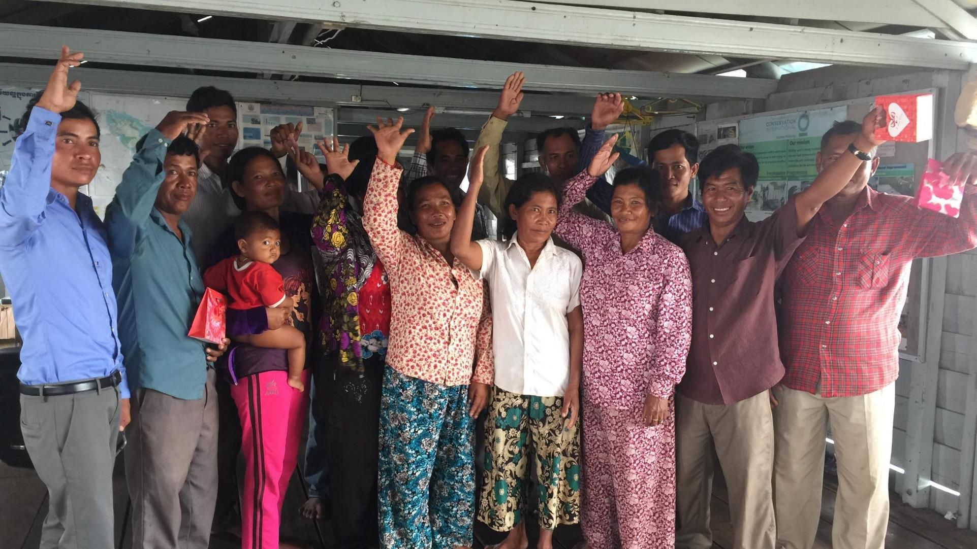
Community Fisheries group reflection about conservation activities in Cambodia.
© Layhim Vann, CI
MODULE 1 | WHY GENDER IS IMPORTANT IN CONSERVATION
Working on gender issues requires
trust
sensitivity
monitoring of impacts
and time
It can be helpful to
collaborate
with organizations & experts that focus on women’s rights, community development, humanitarian aid, etc.
(More in MODULE 3)

Slide 38
Community Fisheries group reflection about conservation activities in Cambodia.
© Layhim Vann, CI
MODULE 1 | WHY GENDER IS IMPORTANT IN CONSERVATION
So:
a)Make sure that each project incorporates gender equality as a goal for project activities, and
b)Work to coordinate gender equality goals, strategies, and activities across different projects over time
Working on gender issues in your organization, project, communities, and positions of influence is a
big effort
It will require more than a small grant!
(More in MODULES 2 + 3)

